Slide 1


Python Web apI - Restful
Django REST framework

Slide 2

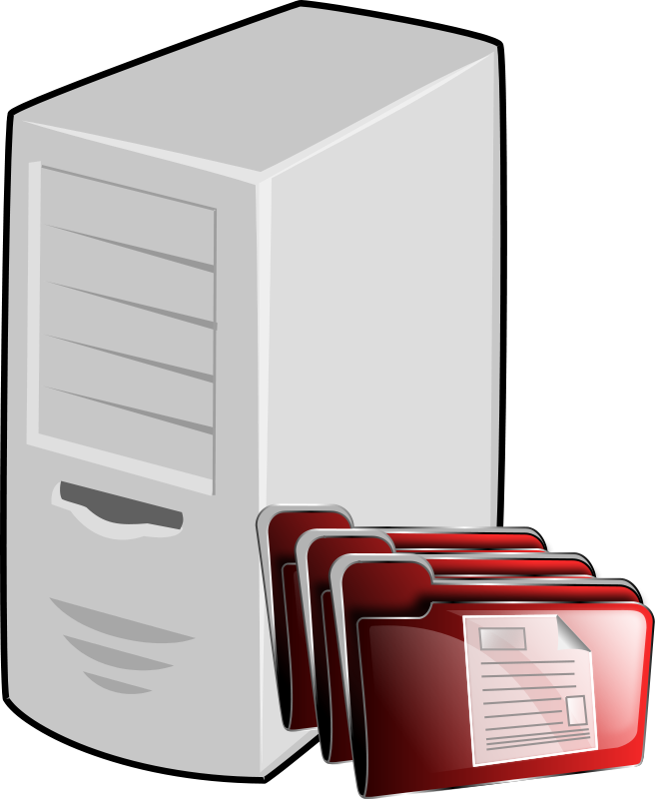

Traditional webapp
Normal webapp / website, is a combination of how to organize data and how to present (chart, table, picture and text).
Browser mainly receive HTML / CSS, or little bit JS for interaction
Main logic was done at backend, backend send HTML to browser
Browsing
Web Server
HTTP
HTTP server,
Django framework,
database

Slide 3
What is restful api
Decouple the data and presentation
A typical production deployment:
Single Page Application, JS router
JS to retrieve data and compose DOM and mount to web page to render to user
WEB (mostly .js static files)
Frontend JS
Data Server,
SPA server
HTTP server,
Django rest framework,
database
API
React, Vue.js, etc.

Slide 4
Some more detail of API
REST: REpresentational State Transfer, building API on top of WEB (HTTP).
Stateless (like HTTP)
Common HTTP verbs (GET, POST, PUT, DELETE, etc)
Return data in JSON or XML
Data server has a set of URL, and they are called Endpoints.
A request to those endpoints will return a response of data, normally in JSON format.

Slide 5
What needed when develop API with Python and django
Python, with virtual environment.
Django
Djang REST framework
PS> pipenv –-python C:\Python310\python.exe
PS> pipenv install django
PS> pipenv install djangorestframework

Slide 6
How to start
Start a Django project same like for a normal webapp:
PS> mkdir proj_folder
PS> cd proj_folder
PS> pipenv –-python C:\Python310\python.exe
PS> pipenv install django
PS> pipenv install djangorestframework
PS> pipenv shell
PS> django-admin startproject proj_name .
If you do not want Django default user model, customize it before your first time run migrate `python manage.py migrate`
This way can save you lots of time if you want change user model but default user database already created.

Slide 7
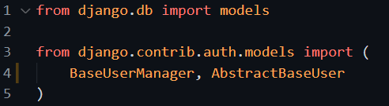
Customize user model
Create a new user app:
PS> pipenv shell
PS> python manage.py startapp user
# user/models.py

Slide 8
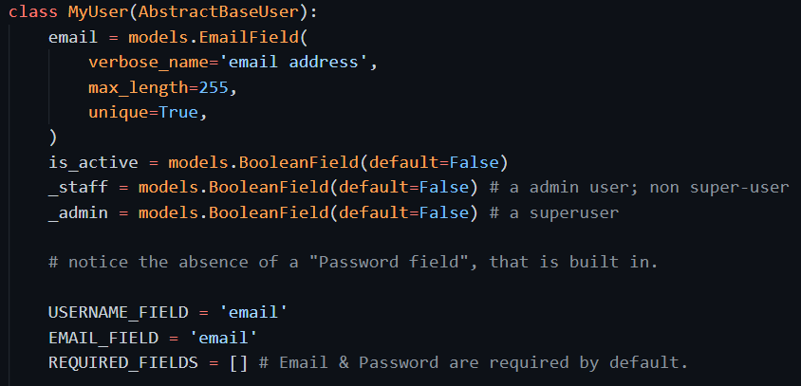
Code for user model
# user/models.py

Slide 9
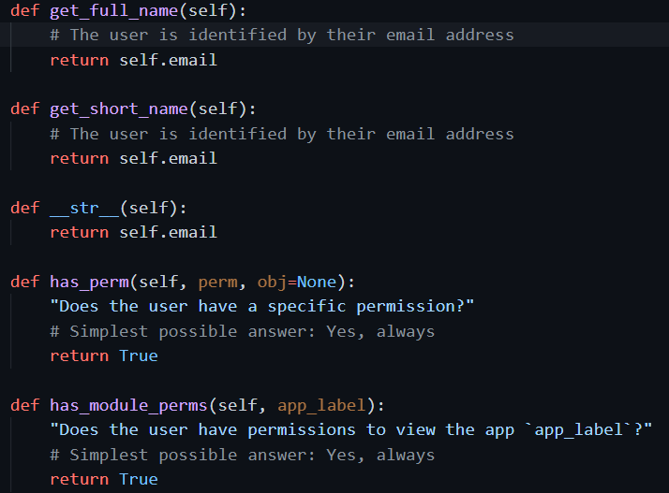
Code for user model
# user/models.py

Slide 10
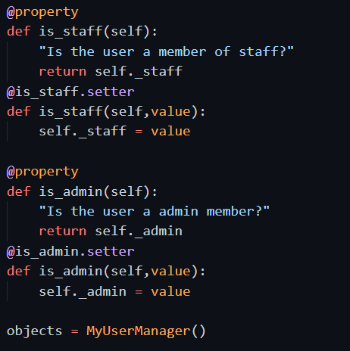
Code for user model
# user/models.py

Slide 11
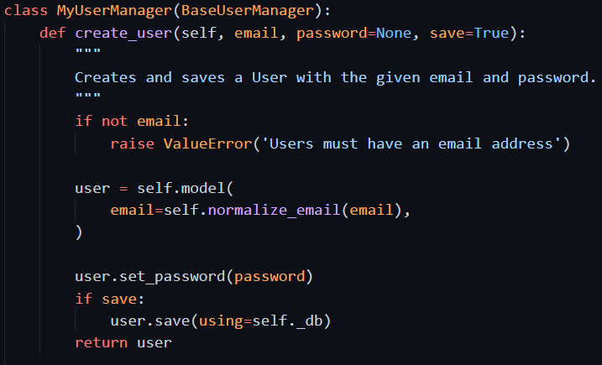
Code for model manager
# user/models.py
Special notice on when saving to DB: the password field must use set_password function. Cannot directly save the string value.

Slide 12
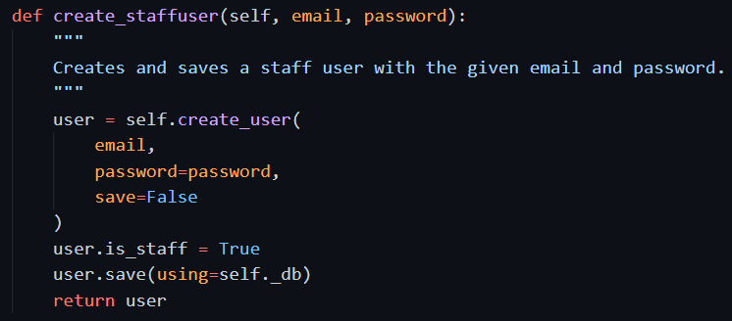
Code for model manager
# user/models.py

Slide 13
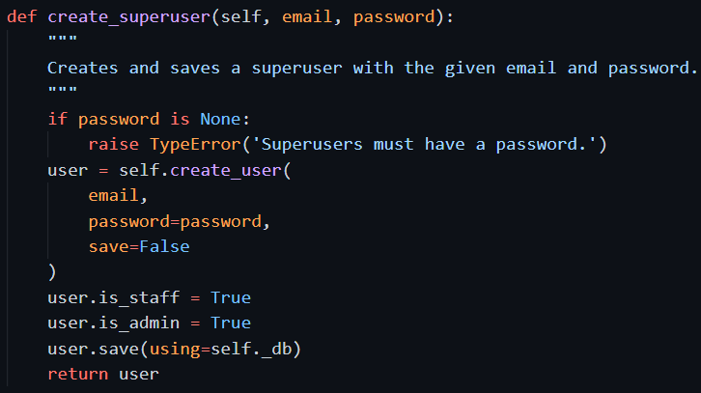
Code for model manager
# user/models.py

Slide 14
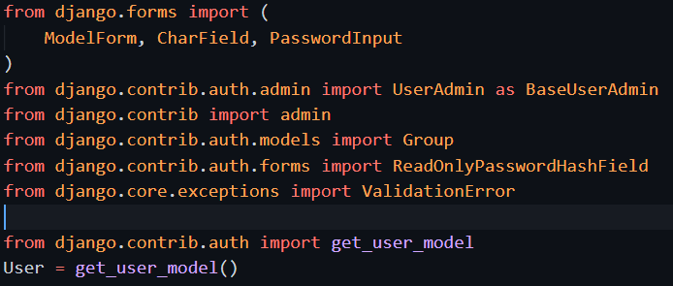
Add user form and register to admin
# user/admin.py

Slide 15
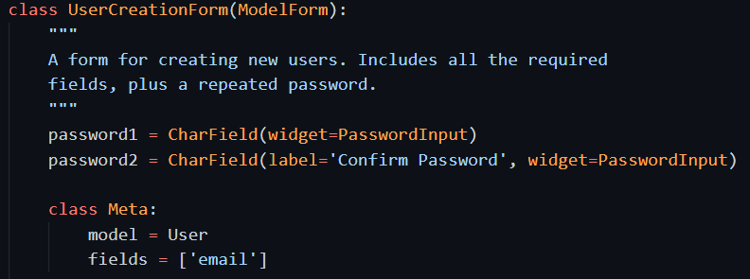
Add user form and register to admin
# user/admin.py

Slide 16
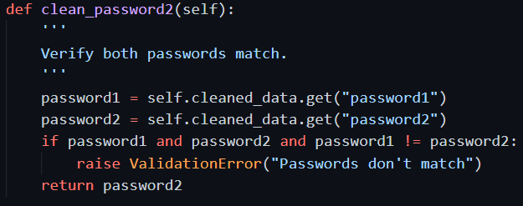
Add user form and register to admin
# user/admin.py

Slide 17
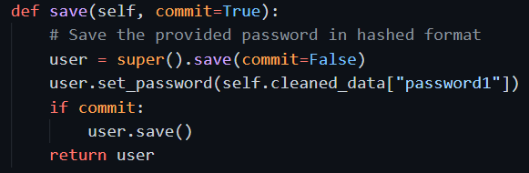
Add user form and register to admin
# user/admin.py
Special notice on save method: the password field must use set_password function. Cannot directly save the string value.

Slide 18
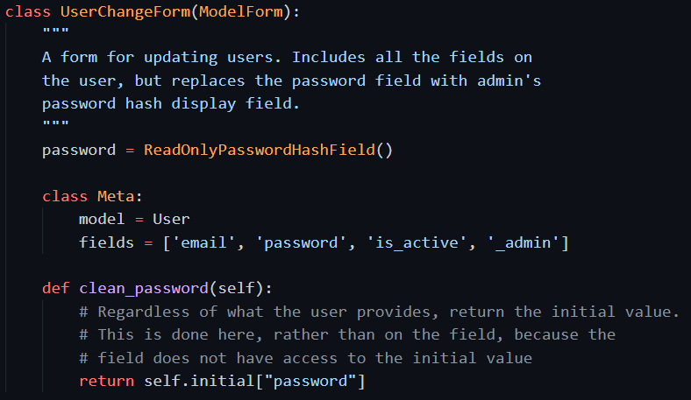
Add user form and register to admin
# user/admin.py

Slide 19
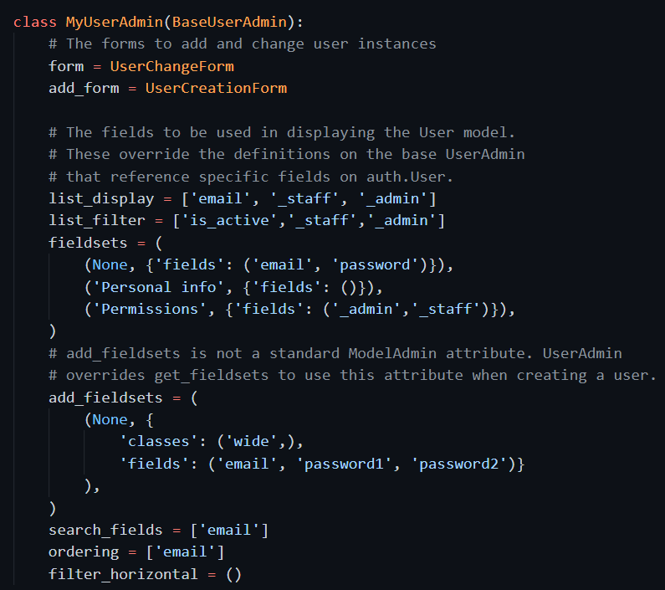
register to admin
# user/admin.py

Slide 20

register to admin
# user/admin.py

Slide 21

Setting.py to set use of new model
Set to use the new model in settings.py
Add the user app to settings.py
`INSTALLED_APPS`
INSTALLED_APPS = [
……, # Django default apps
# added app
'user',
]

Slide 22
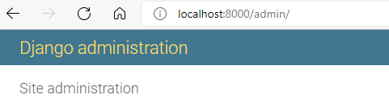
Add the user app to settings, and try it with admin
Migrate and create database
Create superuser
Use django admin page to check
PS> python manage.py makemigrations
PS> python manage.py migrate
PS> python manage.py createsuperuser

